Slide 1
















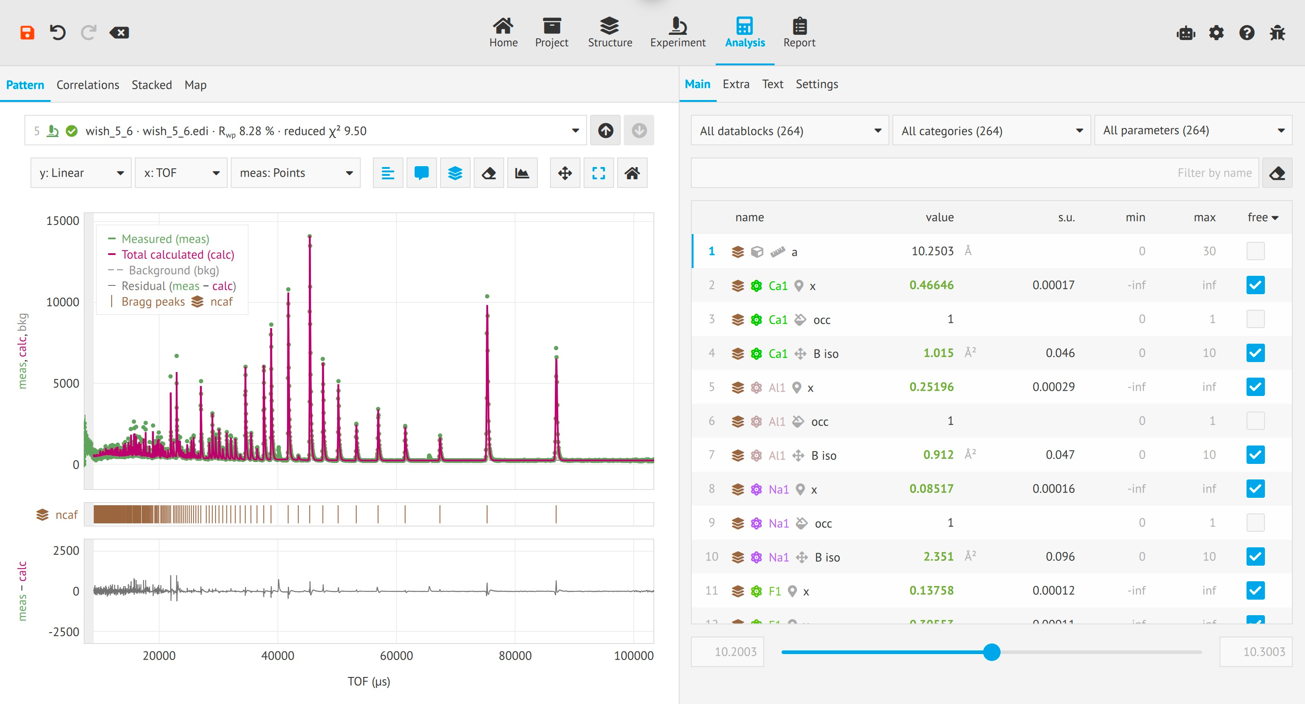
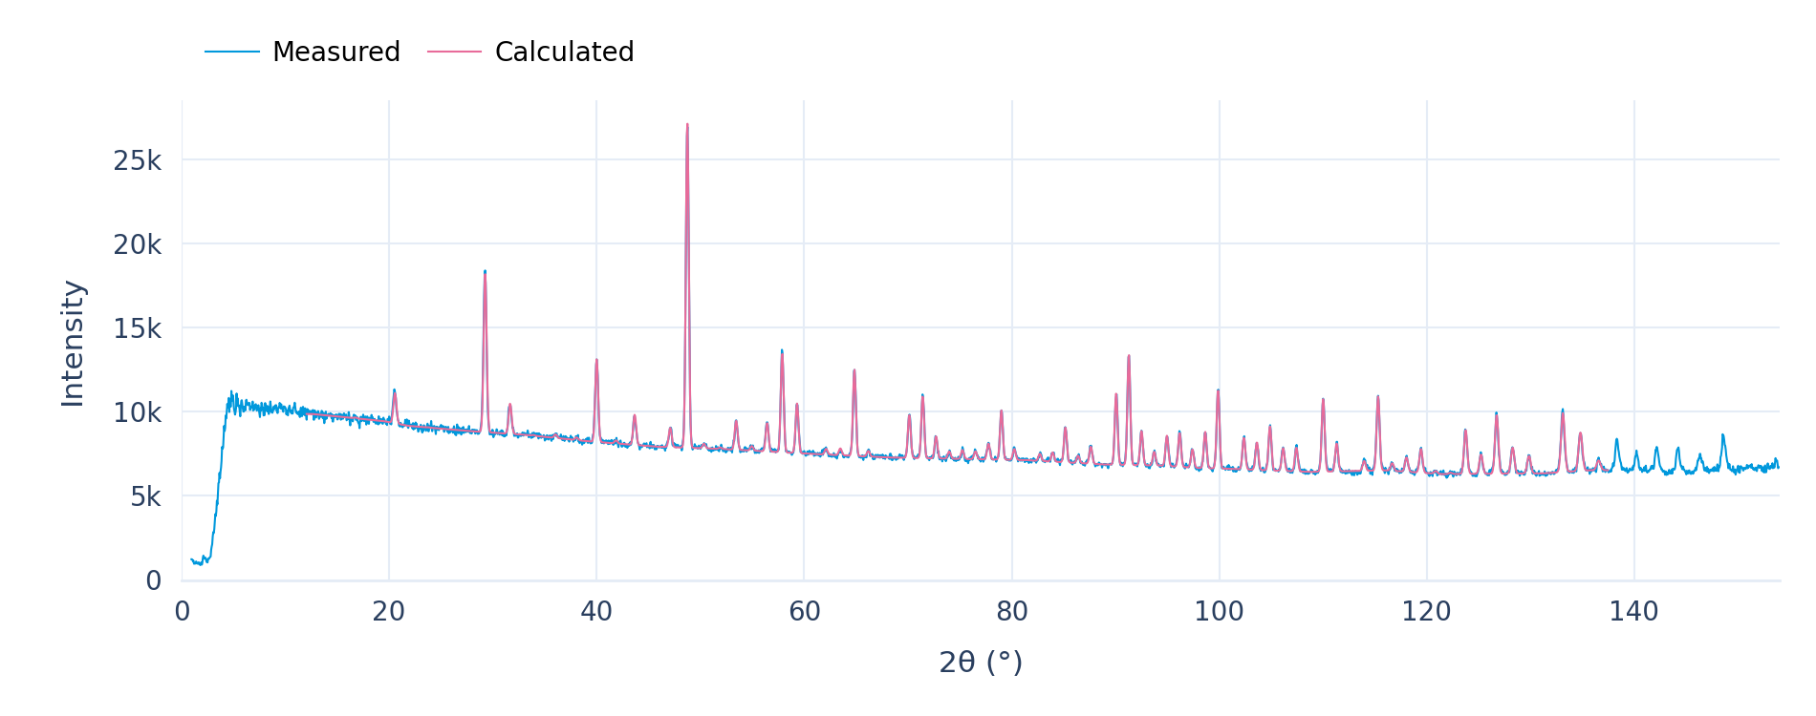



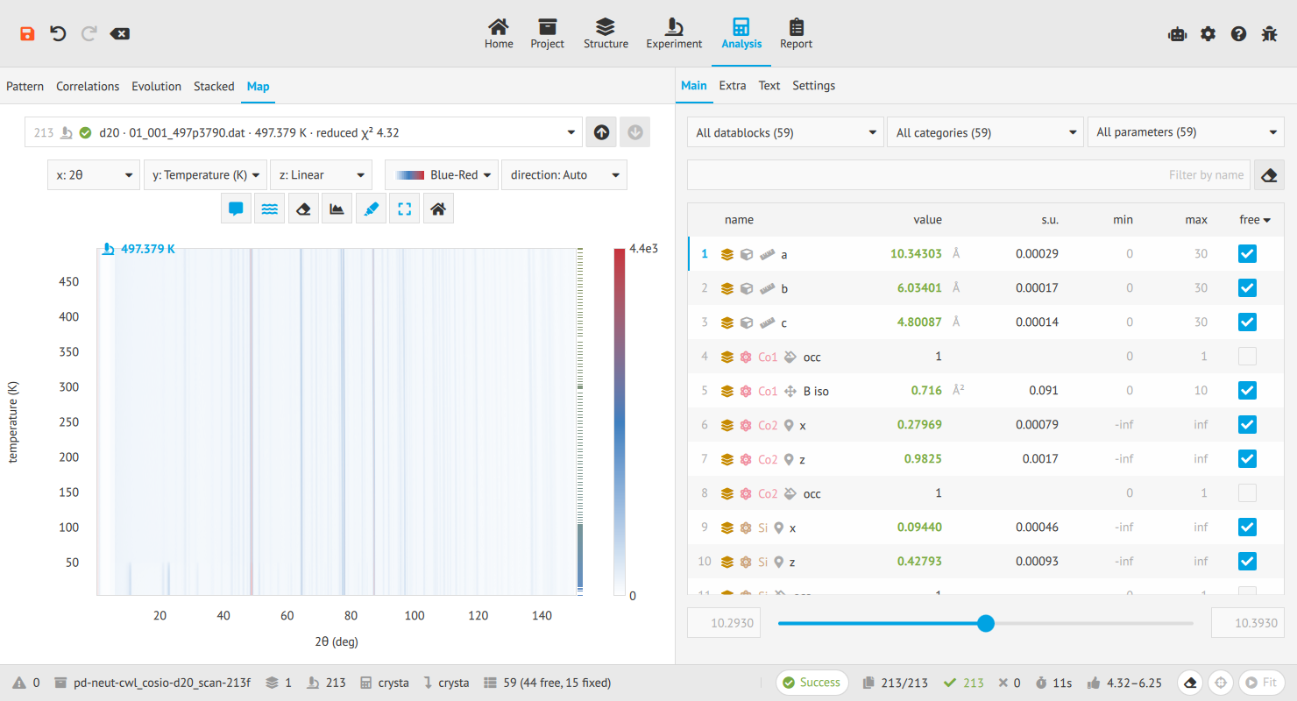


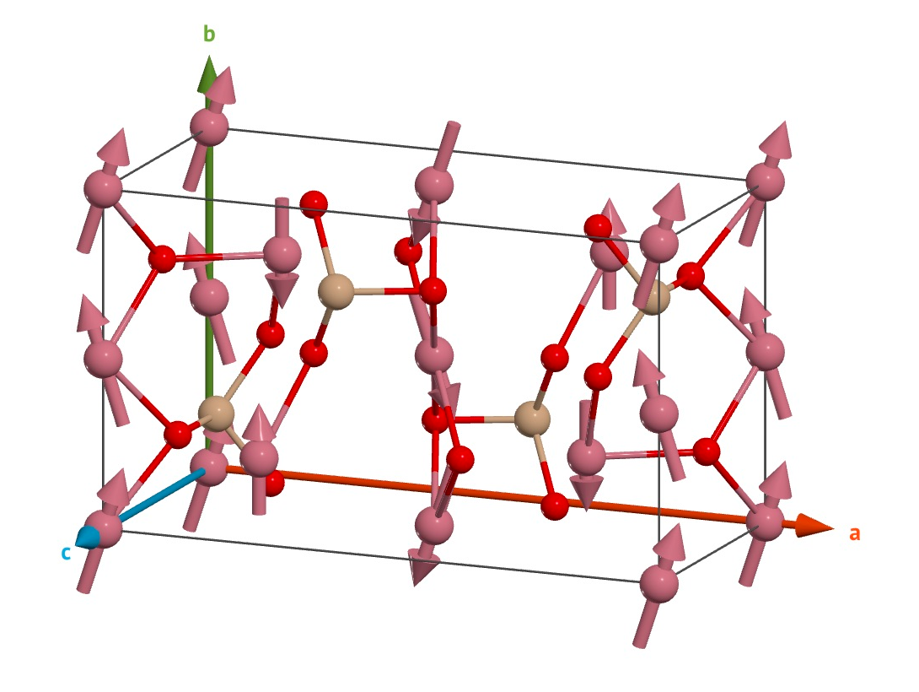
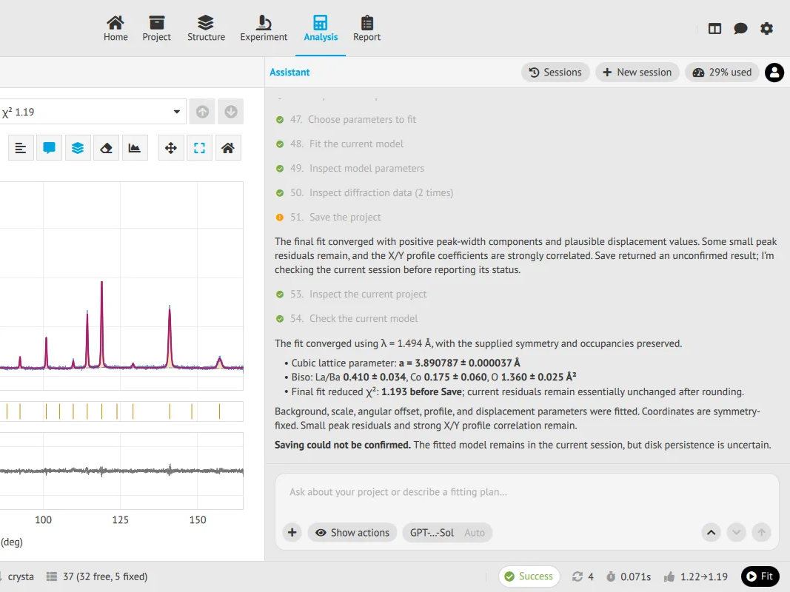
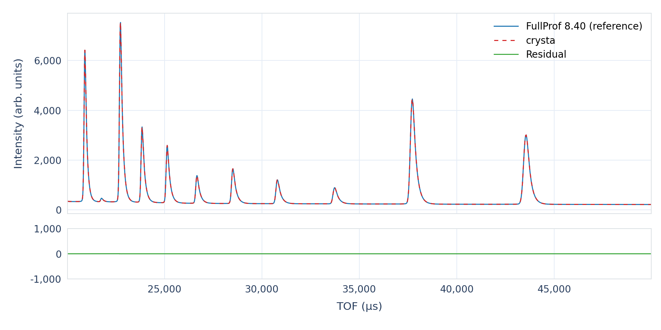
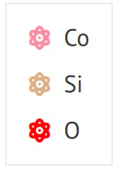



EasyDiffraction and crysta:
Diffraction data analysis at ESS
Andrew Sazonov · andrew.sazonov@ess.eu
European Spallation Source (ESS) · Data Management and Scientific Computing (DMSC)
Diffraction
Fitting
One project · three interfaces
TOF / CW neutrons and X-rays
Single and joint refinement
Application · browser and desktop
Powder and neutron single crystals
Sequential and independent scans
Python · scripts and notebooks
Commensurate magnetic structures
Multiple structures and datasets
Command line · batch workflows
NCAF
WISH · 5 banks · TOF
193 parameters
Bank 5_6
Same start
Python / Jupyter
Y₂O₃
SPODI
AI-ready
In [1]
import edi
case = "pd-neut-cwl_y2o3-spodi"
path = edi.download_data(case)
project = edi.Project.load(path)
In [2]
result = project.analysis.fit()
print(result.rwp)
In [3]
project.report.save_html("fit.html")
project.save()
Measurement series
Map
Co₂SiO₄
D20 / ILL
213 datasets
Speed
FullProf reference
≈3 s
20 s
crysta · C++20
FullProf
NCAF
WISH · 5 banks
193 p.
Same start
6-core VISA Linux VM
5-bank structural parameters ≤0.3 σ
WISH 2+9
48-parameter check
Max Δp 0.69 σ
Median 0.05 σ
Max ΔI≈0.05%
σ: combined standard uncertainty
Unit · integration · system tests
Magnetic fit
Co₂SiO₄
D20 / ILL
2.3 K
Desktop AI
LBCO
HRPT / PSI
Fitted
FullProf check
WISH 2+9
48 p.
Feedback
https://easydiffraction.org
Notes:
Sources and scientific context
Scope and interfaces: https://enhantica.github.io/edi/user-guide/ and the current local edi documentation. Application, Python and Command line icons are the documentation's Font Awesome 5 desktop/terminal and Simple Icons Python.
Python calls: current documentation /python/data/, /python/reference/, /python/results/ and /python/reports/. The example downloads the Y2O3 SPODI project, opens it, refines it, inspects result values, saves an HTML report and saves the project. The plotted output uses the corresponding Y2O3/SPODI measured and fitted data from edi/knowledge/comparison/pd-neut-cwl_y2o3-spodi/edi/spodi.csv (Rwp 0.0134467565 and reduced chi-square 1.1985647351), rendered at taller proportions without altering the data.
Benchmark: abstract-11-2.pdf, EasyDiffraction and crysta for diffraction data analysis at ESS. Na2Ca3Al2F14 from five WISH detector banks, 193 free parameters and the same initial values: approximately 3 seconds for crysta versus 20 seconds for FullProf on the default six-core VISA Linux VM. All refined structural-model parameters agree within 0.3 combined standard uncertainties. The main screenshot shows bank wish_5_6 after a joint fit of the five-bank project. Its status-bar timing is not used as the benchmark.
Earlier verification: 2026.10.07 - LENS WP4 - EDI/index.html#/22/4 and #/23/5. NCAF, WISH banks 2+9 and 48 refined parameters. Largest calculated-pattern difference 3.9 of 7527 counts, approximately 0.05%. Every parameter is within 0.69 combined standard uncertainties of FullProf; median 0.05. This is a descriptive comparison of fits to the same observations, not an independent significance test. The exact plotted vector traces from the original verification SVG are replotted using its axis mapping, with no fitting or re-estimation. The palette and wider aspect ratio suit the poster.
Application captures: current edi documentation assets/gui/y2o3, assets/gui/scan/scan-analysis-map.png and assets/gui/assistant/assistant-fitted.webp. The assistant view is a crop retaining the assistant pane and adjacent fitted-pattern context. The optional built-in assistant is available in the desktop app; external assistants may prepare notebooks or saved projects.
Magnetic structure and atom legend: original GUI capture after fitting pd-neut-cwl_cosio-d20_2k, Co2SiO4 at 2.3 K on D20/ILL. Structure geometry, moment arrows and GUI atom-colour legend are unchanged.
Website and QR destination: https://easydiffraction.org.

